Slide 1


Alkareem
Official Website of Bani KH. Abdul Karim Lirboyo

Slide 2
Alkareem
Link Website
Official Website of Bani KH. Abdul Karim Lirboyo
alkareemlirboyo.com

Slide 3

Link Website
alkareemlirboyo.com

Slide 4

Link Website
Username
Password
alkareemlirboyo.com

Slide 5
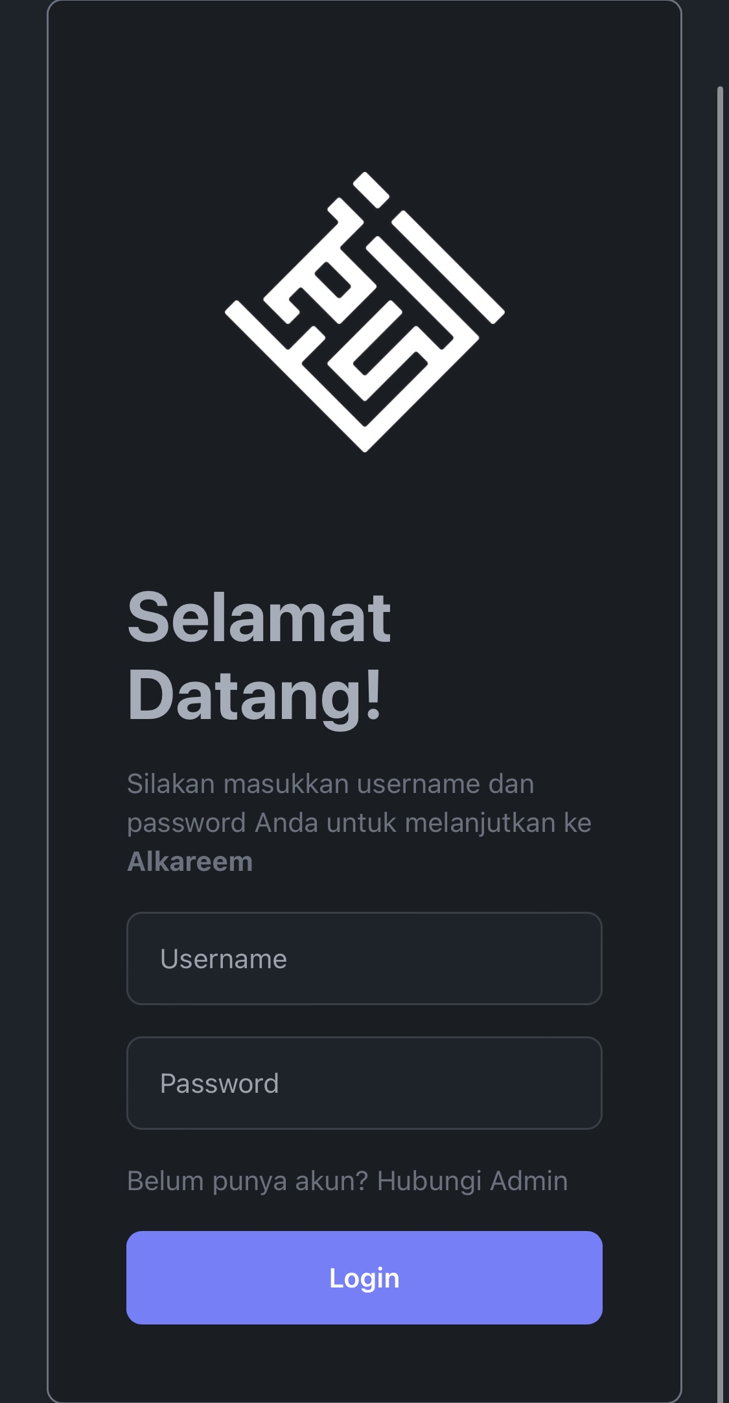
Link Website
Username
alkareemlirboyo.com
Password
Halaman Login

Slide 6
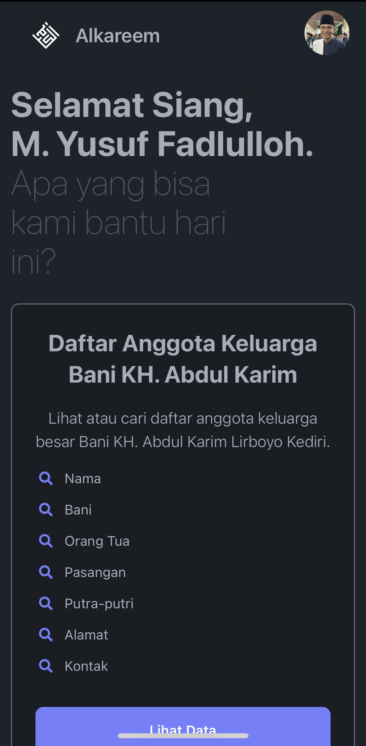
Link Website
Username
alkareemlirboyo.com
Password
Halaman Utama

Slide 7
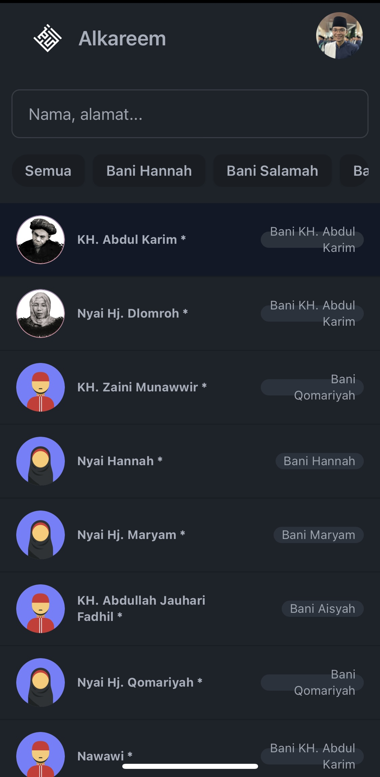
Link Website
Username
alkareemlirboyo.com
Password
Halaman Pencarian

Slide 8
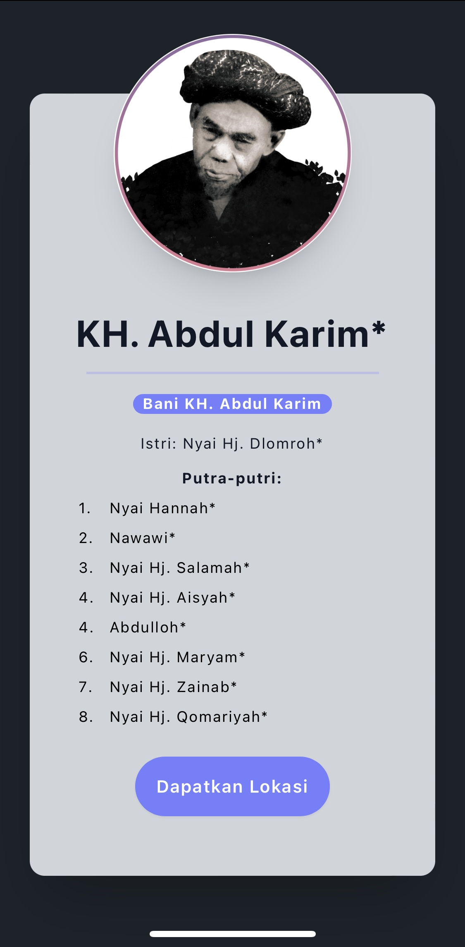
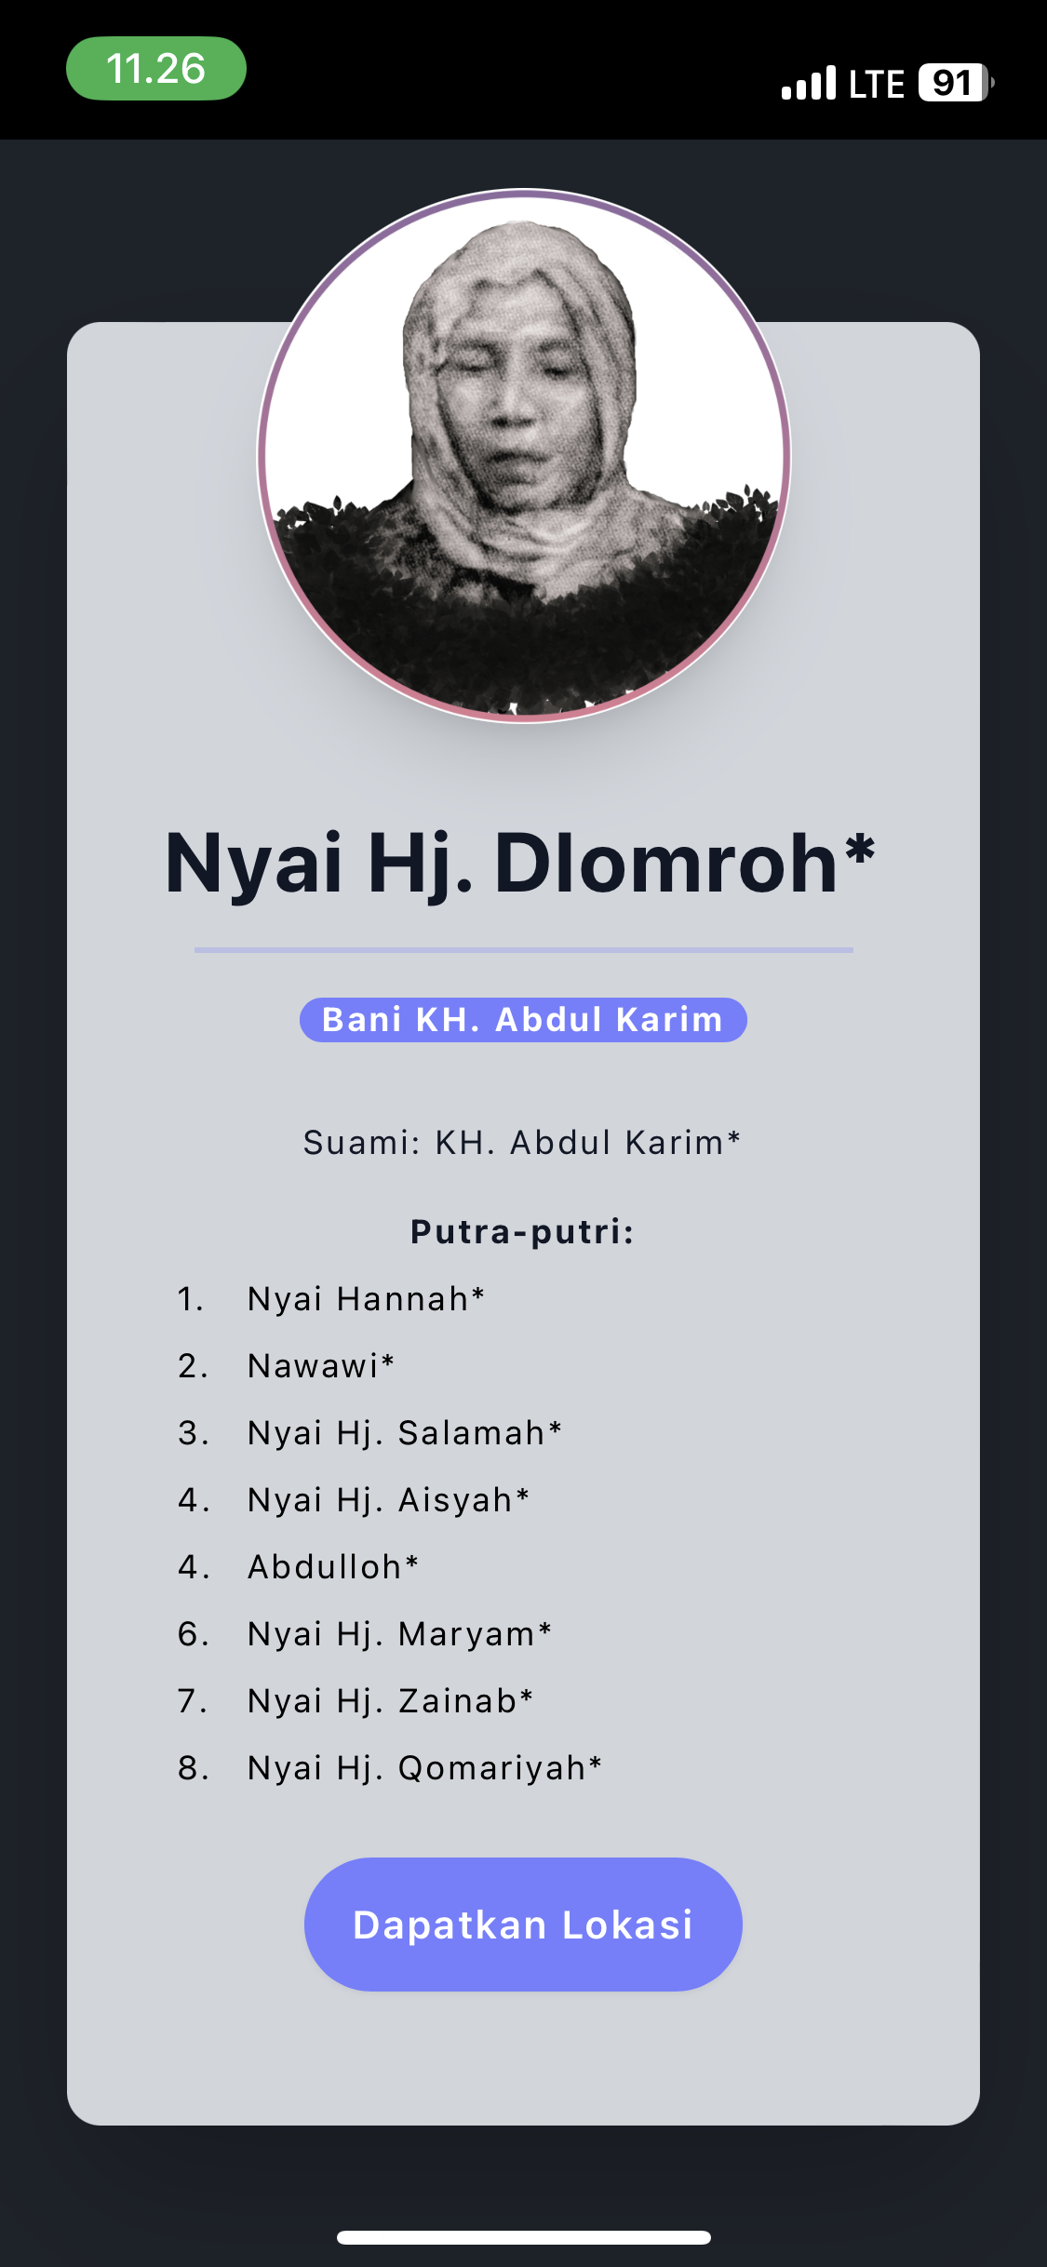
Link Website
Username
alkareemlirboyo.com
Password
Halaman Detail Anggota

Slide 9
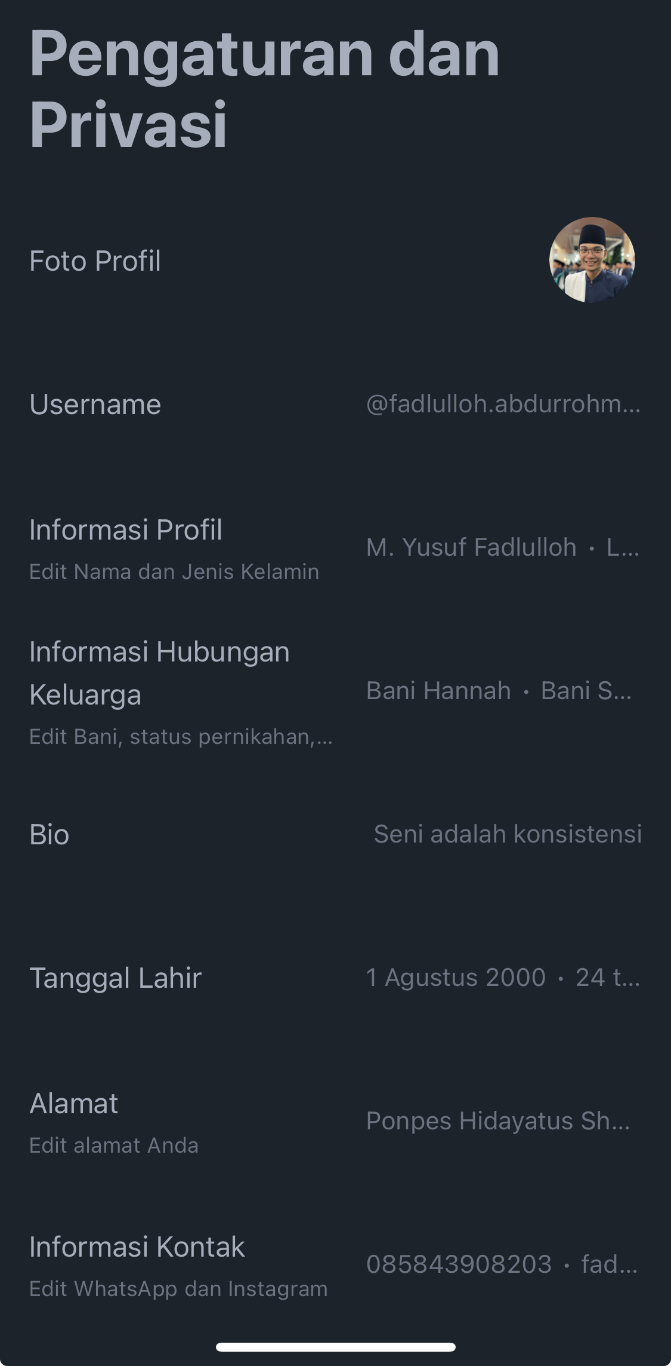
Alkareem
Official Website of Bani KH. Abdul Karim irboyo
Halaman Pengaturan Akun

Slide 10
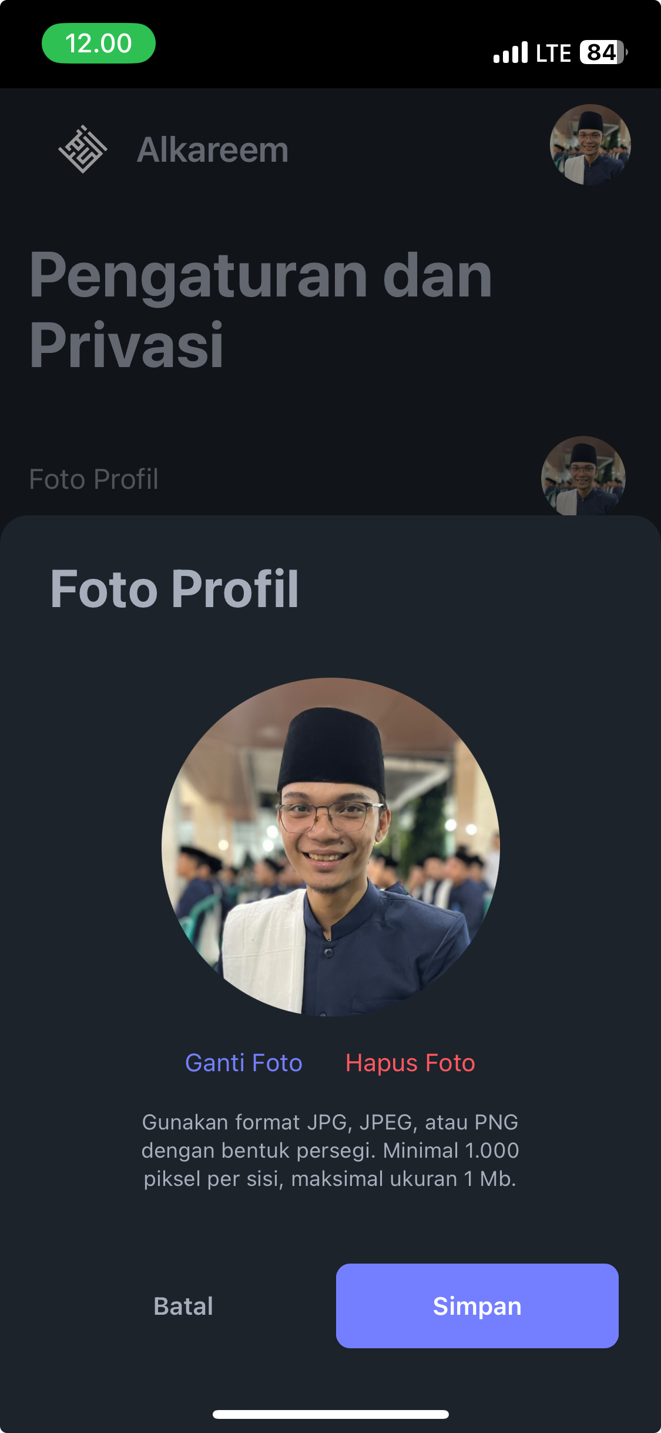
Alkareem
Official Website of Bani KH. Abdul Karim irboyo
Halaman Pengaturan Foto Profil

Slide 11
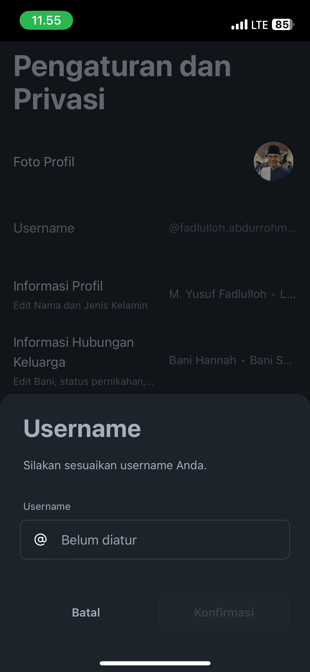
Alkareem
Official Website of Bani KH. Abdul Karim irboyo
Halaman Pengaturan Username

Slide 12
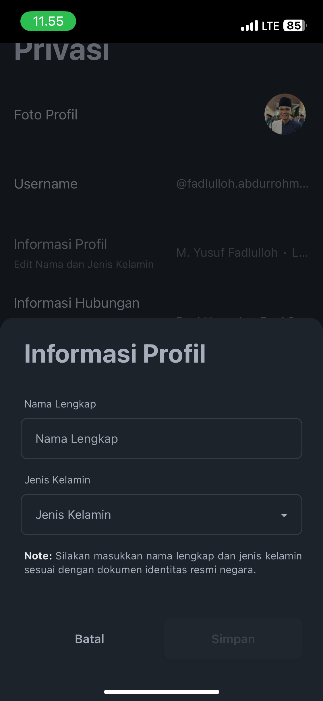
Alkareem
Official Website of Bani KH. Abdul Karim irboyo
Halaman Pengaturan Informasi Profil

Slide 13
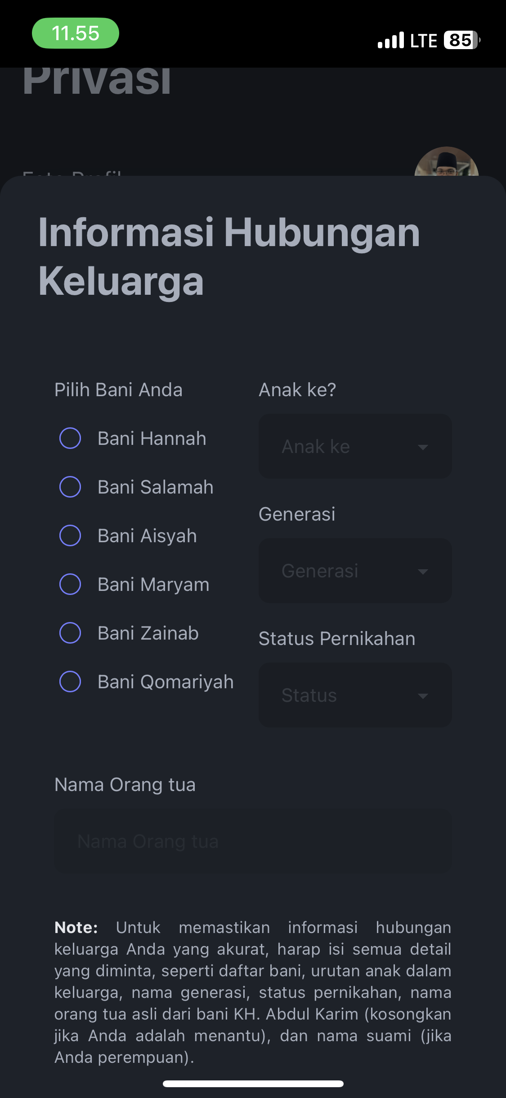
Alkareem
Official Website of Bani KH. Abdul Karim irboyo
Halaman Pengaturan Informasi Hubungan Keluarga

Slide 14
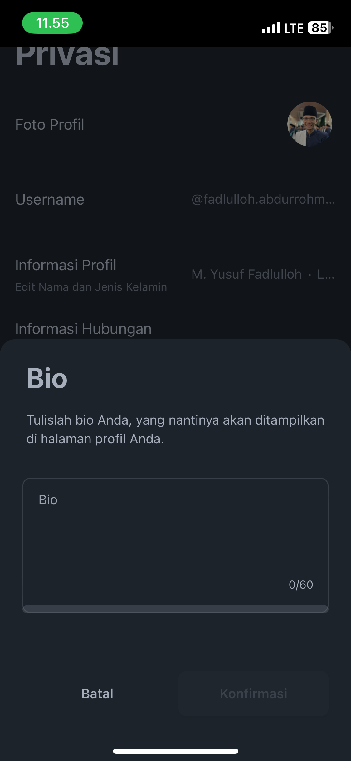
Alkareem
Official Website of Bani KH. Abdul Karim irboyo
Halaman Pengaturan Bio

Slide 15
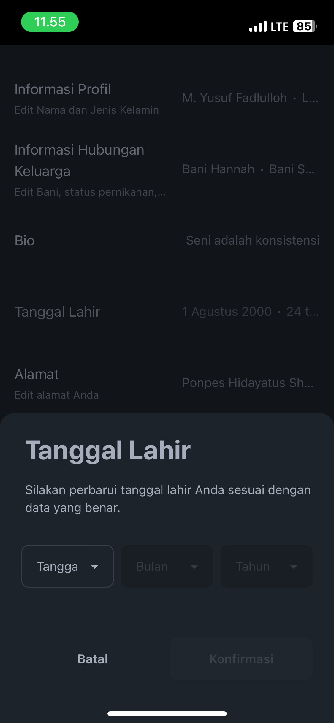
Alkareem
Official Website of Bani KH. Abdul Karim irboyo
Halaman Pengaturan Tanggal Lahir

Slide 16
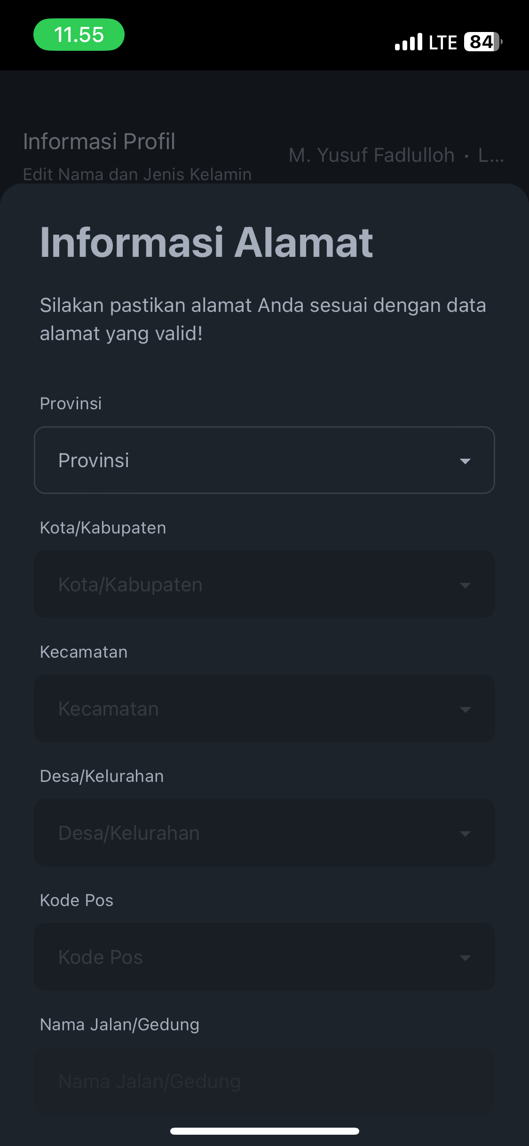
Alkareem
Official Website of Bani KH. Abdul Karim irboyo
Halaman Pengaturan Informasi Alamat

Slide 17
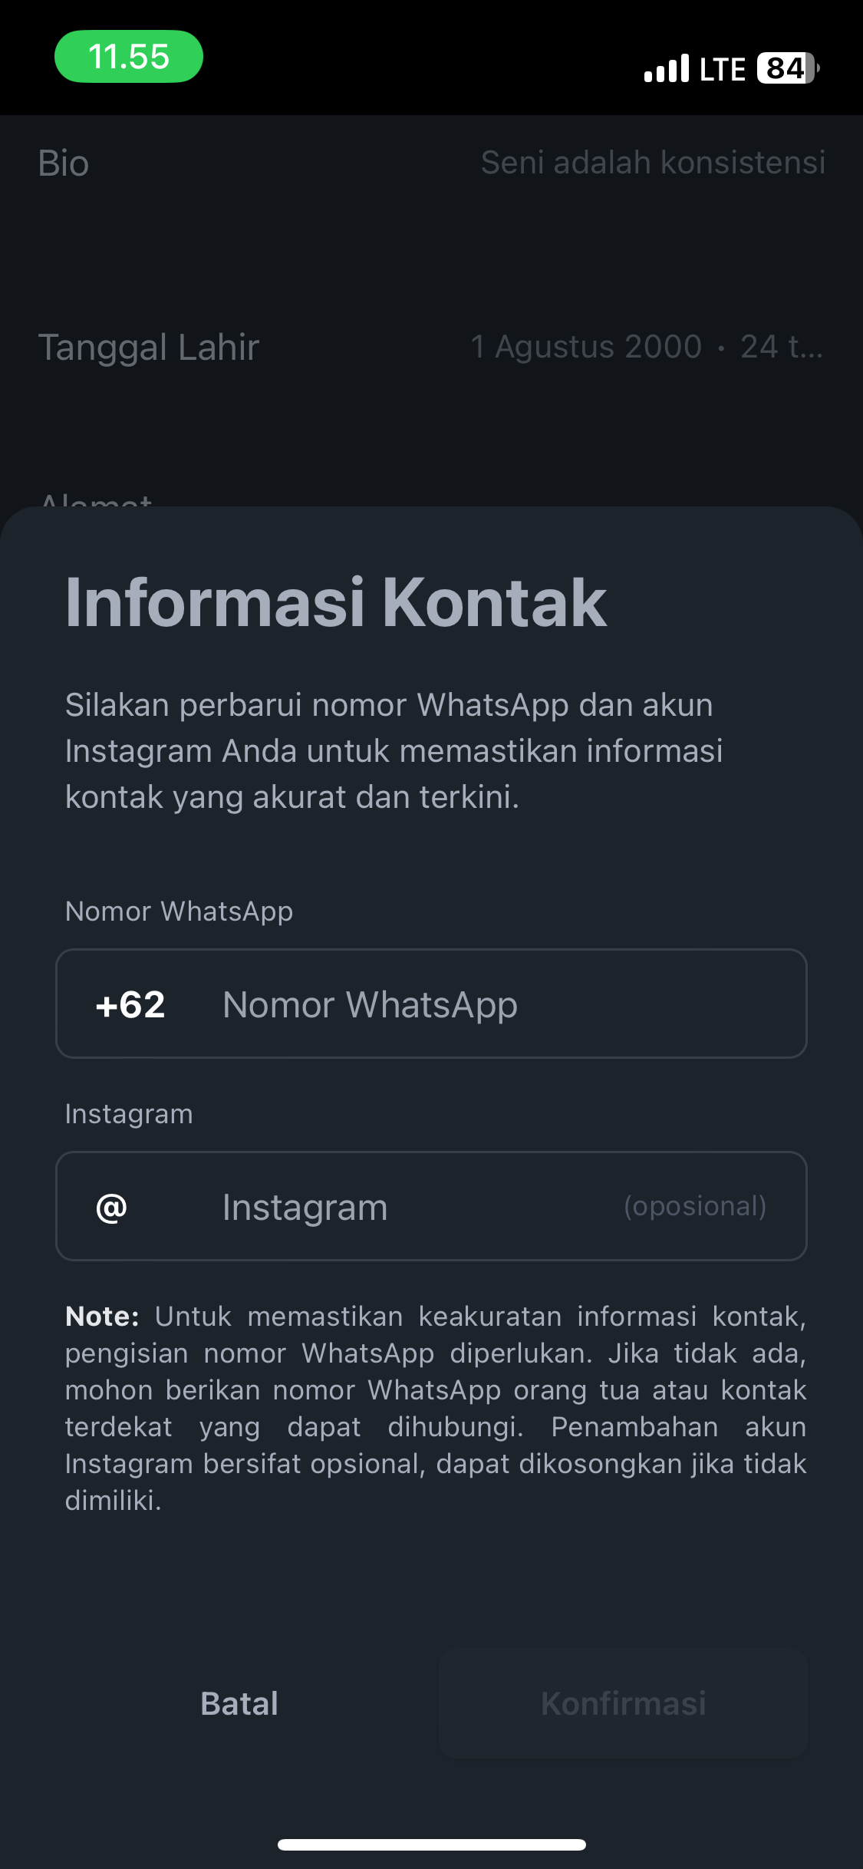
Alkareem
Official Website of Bani KH. Abdul Karim irboyo
Halaman Pengaturan Informasi Kontak

Slide 18
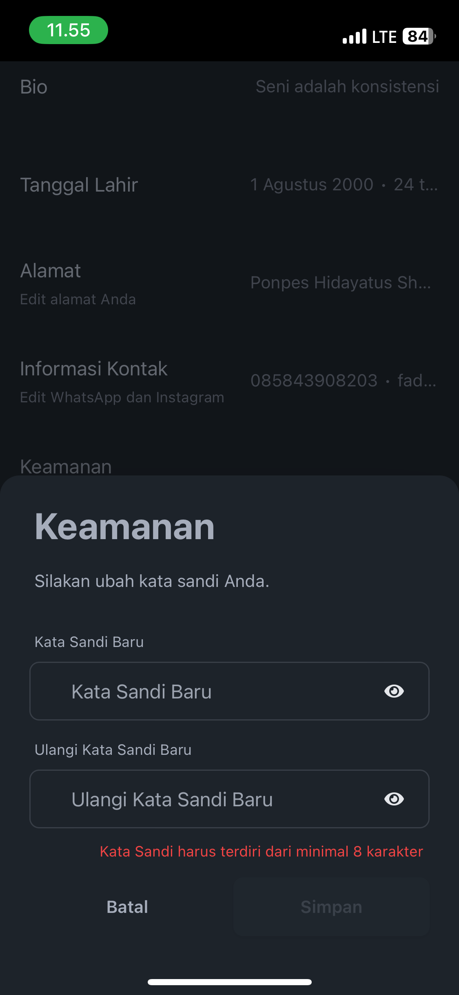
Alkareem
Official Website of Bani KH. Abdul Karim irboyo
Halaman Pengaturan Kata Sandi

Slide 19
Alkareem
Link Website
Official Website of Bani KH. Abdul Karim irboyo
alkareemlirboyo.com

